Slide 1

The impact of data preprocessing on the quality of tree-based models with forester package.
Methodology
Author: Hubert Ruczyński,
Supervision: Anna Kozak, Anna Cena
Warsaw University of Technology
Notes:
Hi, during the previous presentations, which occurred during the last semester I had an opportunity to introduce you to the forester project, including the project origins as my Bachelor’s degree thesis. I talked about the reasons that led to the package creation, what were the most important goals for us, and additionally I showed some studies from published or just written papers through my journey with this subject. Actually, the last presentation focused more on the current tasks of my Master’s thesis, and I talked mostly about the studies that analyze the impact of preprocessing on different machine learning models.
Today’s talk on the other hand will Focus on the methodology incorporated for the sake of current Thesis.

Slide 2
Thesis goals
1. The purpose of this work is to investigate the impact of data preprocessing on the quality of modeling using tree-based models in binary and multiclass classifications and regression tasks.
2. The indirect result of the work is the implementation of selected techniques in the form of an extension to the R language package called forester.
Notes:
At this point, let’s remind the main goals of my Master’s Thesis.
As mentioned in its title: The purpose of this work is to investigate the impact of data preprocessing on the quality of modeling using tree-based models in binary and multiclass classifications and regression tasks.
Additionally, the indirect result of the work will be the implementation of selected techniques in the form of an extension to the R language package called forester.

Slide 3
forester recapped
The forester is an AutoML tool in R for tabular data multiclass, and binary classification, as well as regression tasks that wraps up all machine learning processes into a single train()function, which includes:
1. rendering a brief data check report,
2. preprocessing the initial dataset enough for models to be trained,
3. training 5 tree-based models with default parameters, random search, and Bayesian optimization,
4. evaluating them and providing a ranked list.
However, that’s not everything that the forester has to offer. Via additional functions, the user can easily prepare a custom preprocessing pipeline, explain models with the usage of DALEX, or generate one of the predefined reports including:
1. information about the dataset,
2. in-depth parameters of trained models,
3. visualizations comparing the best models,
4. explanations of the aforementioned models.
Notes:
Now, as not everyone here was present during the last semester seminar, I’ll quickly remind you what the forester package is.

Slide 4
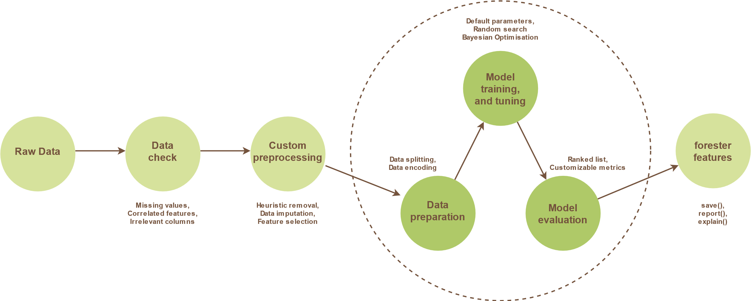
forester pipeline
Notes:
The package pipeline is presented on the current slide.
The main addition to this framework is the introduction of a custom preprocessing module, which lets the users, quickly turn on, and off various preprocessing strategies, so they can be suited for particular tasks.
The custom preprocessing is divided into three areas, being heuristic removals, data imputation, and feature selection.

Slide 5
Custom preprocessing
1. Heuristic removals:
Duplicated columns,
Id-like columns,
Static columns,
Sparse columns,
Highly correlated,
Corrupted rows.
2. Data Imputation:
Median-other,
Median-frequency,
KNN,
MICE.
3. Feature Selection:
Mutual Information,
Boruta,
MCFS,
Variable Importance.
Notes:
The first one uses up to 6 separate criteria that determine whether columns or rows should be removed or not, being: Duplicate, Id-like, Static, Sparse, or Highly correlated columns, and Corrupted rows.
The second area focusing on data imputation, lets the user choose one of four methods being: median-other, median-frequency, k nearest neighbors, or multivariate imputation by chain equations.
The last sub-module contains four feature selection methods, such as the mutual information-based method, boruta, Monte Carlo feature selection, and variable importance.
In terms of regular usage of the tool, it enables the user to easily modify a preprocessing pipeline, just for their own dataset needs, whereas in terms of the thesis, it simplifies conducting of experiments a lot.

Slide 6
Datasets
In the study, we used various datasets: 10 for binary classification, 9 for multiclass classification, and 9 for regression, where 6 of them (2 per task) are modified as follows:
We added the ID column,
We added two static columns, where the first one consists of repeated number 1, whereas the second one mostly has letter a, and sometimes letter b,
We randomly sampled two original columns, and created duplicates of them,
We randomly selected three original columns (with the exclusion of the ones used in the previous step) and introduced missing values to them. The amount of missing elements per column are 5\%, 10\%, and 15\%.
Notes:
The first part of the methodology for this study is the choice of the data. It is crucial to ensure a variety of data sources, and tasks, to ensure that the preprocessing module is going to face different difficulties and quality issues. Because of that, we decided to test our solution on 28 datasets, 10 for binary classification, and 9 for both regression and multiclass classification. The details about those datasets will be presented on the following slides, however before that, I want to talk about another small issue.
Apparently, it is quite a hard task to find the benchmarking dataset which presents lots of data quality issues. Due to this fact, we decided that for each of the aforementioned task types, we have to artificially create quality issues, to properly test the impact of data preprocessing in corner cases. For each task, we selected two datasets, one with a small number of columns, and the second one with high dimensionality, and introduced the following changes to them:
We added the ID column,
We added two static columns, where the first one consists of repeated number 1, whereas the second one mostly has letter a, and sometimes letter b,
We randomly sampled two original columns, and created duplicates of them,
We randomly selected three original columns (with the exclusion of the ones used in the previous step) and introduced missing values to them. The amount of missing elements per column are 5\%, 10\%, and 15\%.

Slide 7
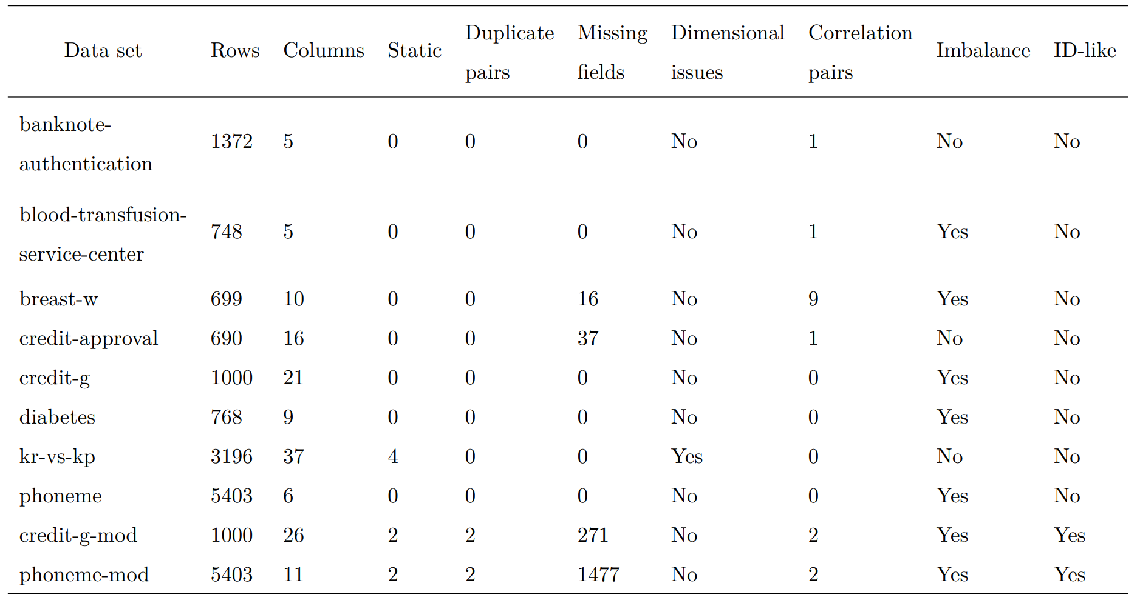
Datasets – binary classification
Notes:
As presented in Table the binary classification tasks are small to medium sizes, with kr-vs-kp being the largest. Only one dataset originally has static columns, and not a single task suffers from the duplicates, however, two of them contain missing fields. Additionally, the aforementioned kr-vs-kp has a problem with a too big number of columns, which will be discarded by tree-based models. Unfortunately, half of the tasks have at least one pair of highly correlated columns, whereas breast-w has 9 highly correlated pairs. Finally, most of the tasks are imbalanced, but none of them originally contain id-like columns. The artificially modified datasets are credit-g-mod, and phoneme-mod.
What’s also notable is the fact that the datasets were not chosen randomly, but they are part of the AutoML benchmark called OpenML-CC18, which is one of the most widely used solutions in our domain field. This fact is quite interesting as it shows us that the AutoML solutions are mainly tested on high-quality datasets, and their performance for real-life tasks might be overestimated.

Slide 8
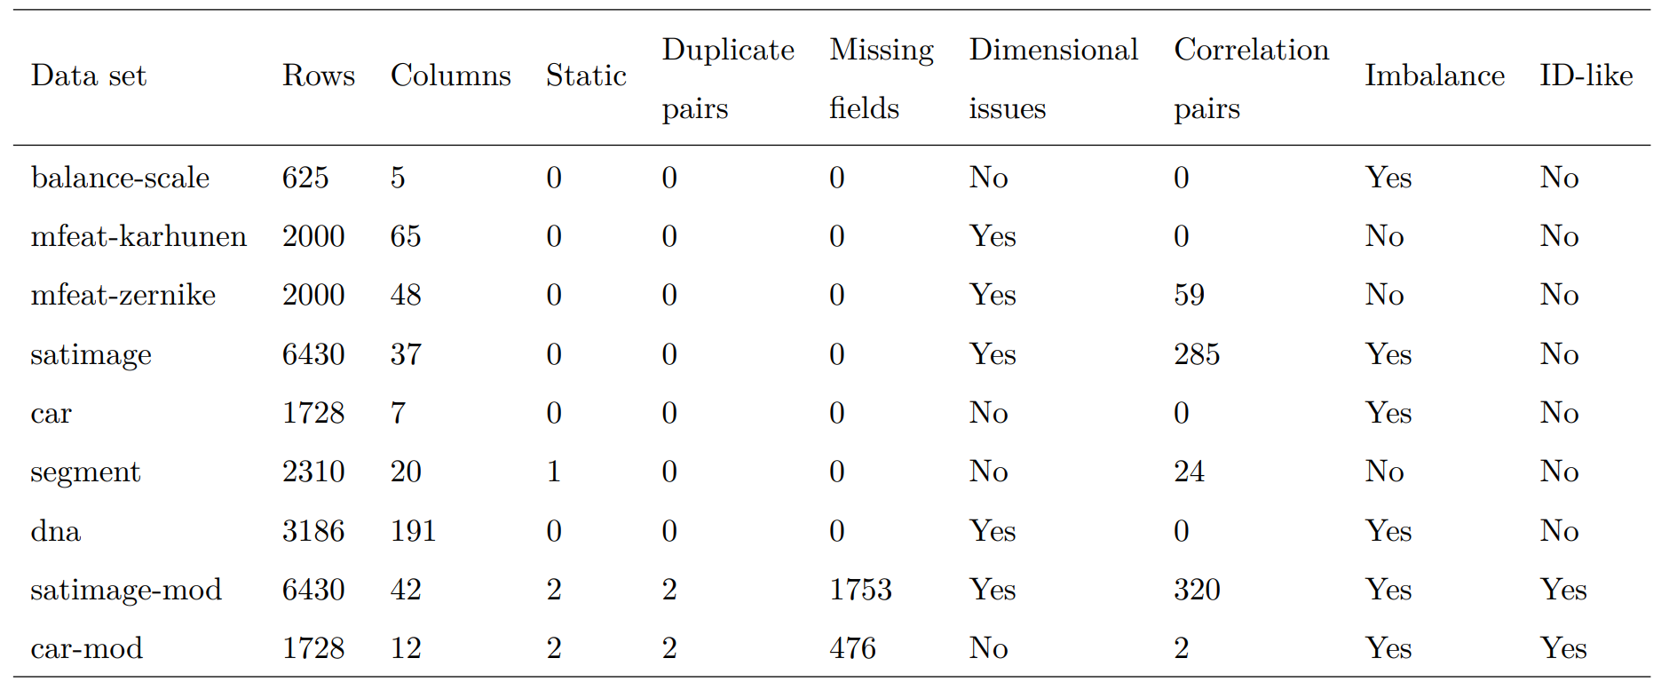
Datasets – multiclass classification
Notes:
The multiclass classification tasks, which are of moderate size, stand out from the previous ones because of generally higher dimensionality. The biggest dataset is called dna, and it almost reaches 200 columns. Due to the higher dimensionality, in this case, we can also observe more highly correlated columns than before. The artificially modified datasets are satimage-mod, and car-mod. In this case, the datasets also come from the OpenML-CC18 benchmark.

Slide 9
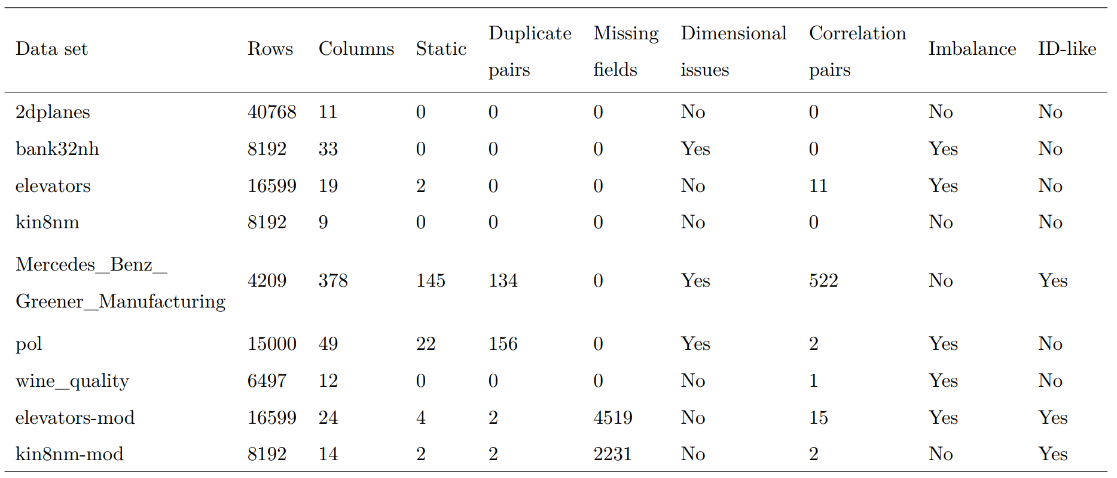
Datasets – regression
Notes:
Table datasets-regression presents regression tasks, which are much bigger than the previous ones, and presents more examples of corrupted data. The most problematic datasets are Mercedes\_Benz\_Greener\_Manufacturing, and pol. These tasks are the largest ones and contain lots of static columns, as well as an abundance of duplicate ones. Mercedes\_Benz\_Greener\_Manufacturing additionally has a huge amount of highly correlated columns, and at least one id-like column. In general, regression tasks also introduce more scenarios with dimensionality issues, as well as imbalanced target variables. The artificially modified datasets are elevators-mod, and kin8nm-mod.
This time the data doesn’t come from CC-18, but hey are still available via the OpenML.

Slide 10
Preprocessing strategies
Removal strategies:
Minimal (min) - Baseline method that removes observations that do not have the target,
Medium (med) - It removes duplicate, id-like, static (threshold = 0.99), and sparse (threshold = 0.3) columns and corrupted rows with too many missing values (threshold = 0.3),
Maximal (max) - The same as the medium option, but, it also removes the columns with a correlation higher than 0.7.
Notes:
In order to conduct the preprocessing methods study we had to prepare various strategies. However, we were not able to cover the full space of possibilities. If we wanted to do so, even without tuning the parameters such as threshold, we would end up with 576 approaches, derived from 36 removal, 4 imputation, and 4 feature selection strategies. To end up with a reasonable amount of outcoming datasets, we had to limit this number significantly, thus we prepared 3 removal strategies:
points
With such strategies, we were able to obtain the results where removal does not have a major impact (min), where we use safe and reasonable options (med), and where we additionally apply unstable highly correlated column removal (max). With those limitations, we would end up with 48 datasets.

Slide 11
Preprocessing strategies
Preprocessing strategies:
RM - tests all removal strategies, where other modules are set to the most basic options: median-other for imputation, and none for feature selection. (3)
IMP - tests all imputation methods, where other modules are set to the most basic options: min for removals, and none for feature selection. (4)
FS - tests all feature selection methods, where other modules are set to the most basic options: min for removals, and median-other for imputation. (4)
RM + IMP - tests med and max removal options combined with all imputation methods. (8)
RM + FS - tests med and max removal options mixed with all feature selection methods. (8)
IMP + FS - tests all imputation methods with MI and BORUTA feature selection. (8)
RM + IMP + FS - tests med and max removal options combined with median-frequency,
median - other and KNN imputation, and MI and BORUTA feature selection. (12)
Notes:
Even though, we have decided to limit it even further. The feature selection method is in some cases extremely time-consuming, thus we limited the number of experiments with those, by thoroughly testing only the two fastest options. Finally, we ended up with 45 preprocessing strategies (eventually represented by 38 unique parameter settings, more in Appendix B) described in the list below:

Slide 12
Resulting datasets
28
datasets
38
strategies
Notes:
Eventually, the experiments were conducted on 28 binary classification, multiclass classification, and regression datasets of various characteristics. For each of them, we used the aforementioned 38 preprocessing strategies, which finally led to 1064 datasets.

Slide 13
Model Training
For the training procedure for each of the 1064 datasets, we use the train() function where:
We split the dataset into training, testing, and validation samples (60%, 20%, 20%),
We use the random search tuning method only, as Bayesian Optimisation would take too long, and the results would be less dependent on the data,
We train 105 models (1 set of default parameters, and 20 random searched ones) from 5 engines. The models used are: decision tree, random forest, XGBoost, CatBoost, and LightGBM,
We save the achieved outcomes along with the training time.
Notes:
The last step is the model training, where we also incorporate the forester package. The train() function is used for all 38 preprocessed versions of 28 datasets.
Each data frame was split into training, testing, and validation samples, with the proportions 60%, 20%, and 20%, respectively. To ensure reproducibility of the results, we set the split seed to 123.
To limit the computational time, we only used random search as a tuning method, because it is more beneficial for ablation studies than Bayesian optimization. The latter option would take too long to run, the results would be more random, as different runs of this algorithm lead to various results, making it diﬀicult to see the effects of the preprocessing.
Eventually, for each dataset, we create 5 models with default parameters, one per engine: decision tree, random forest, XGBoost, CatBoost, and LightGBM, and 100 models (20 models for each engine) with their parameters chosen by the random search algorithm.
We save the achieved outcomes, and additionally, measure the time of the training, as it is useful for further analysis.

Slide 14
Number of trained models
111 720
models
28
datasets
38
strategies
105
models
Notes:
Finally, we ended up with 111 720 models for the whole study.

Slide 15
Current state and Further Works
Recently released forester version 1.5.0, where we added the multiclass classification task,
Selected, and prepared the datasets for experiments,
Almost fully prepared code for calculating the experiments,
Getting the access to PLGrid computational server for calculations,
Written the first version of the Methodology related chapters,
FW – Getting accustomed to PLGrid, and running the experiments.

Slide 16
Thank you for attention!
Notes:
So, thank you for your attention. I hope you enjoyed this presentation, and I'm open to some discussion and questions regarding our topic.

Slide 17
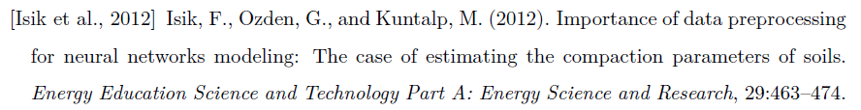
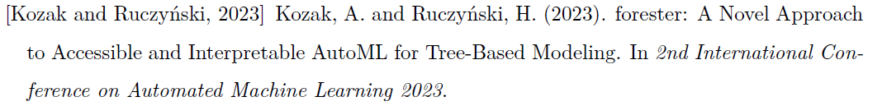
Literature

